Slide 1

Butler Accommodation Talk

Slide 2
Take your time.
Take your time deciding who you’re living with
Landlords want you to sign as early as possible
Finding good housemates is better than finding a good house!
ALWAYS ASK YOURSELF:
- Who do I want to live with? - Where do I want to live? - Why do I want to live out/in?

Slide 3
Find a housemate evenings
Butler Bar & DSU – January
More information soon
People who have no idea who to live with
Groups who still need one or two to make up numbers

Slide 4
Rented accommodation
52 week contract, £2600 - £4700 + Bills
Pros – Can be closer to town/lectures Better furnishings (Double Beds etc.) Learn valuable life skills Greater Independence
Cons – Bills usually not included Landlords/residents Strain of ‘group living’ Less Security Difficult to find nearby housing for extensive friendship groups

Slide 5
Returner flats
Eighteen 6 beds, one 4 bed
£4392 for 38 weeks (£115.58 per week for 38 weeks) – Works out at £84.86 per week when spread out over 52 weeks!
Pros – All bills included Every room en suite At the heart of college life Cleaners Porters Guaranteed high-speed Internet from the off Finalists get extra week Returners get a sofa for their kitchen
Cons – Distance Can’t stay over summer Furnishings (Single Beds)

Slide 6
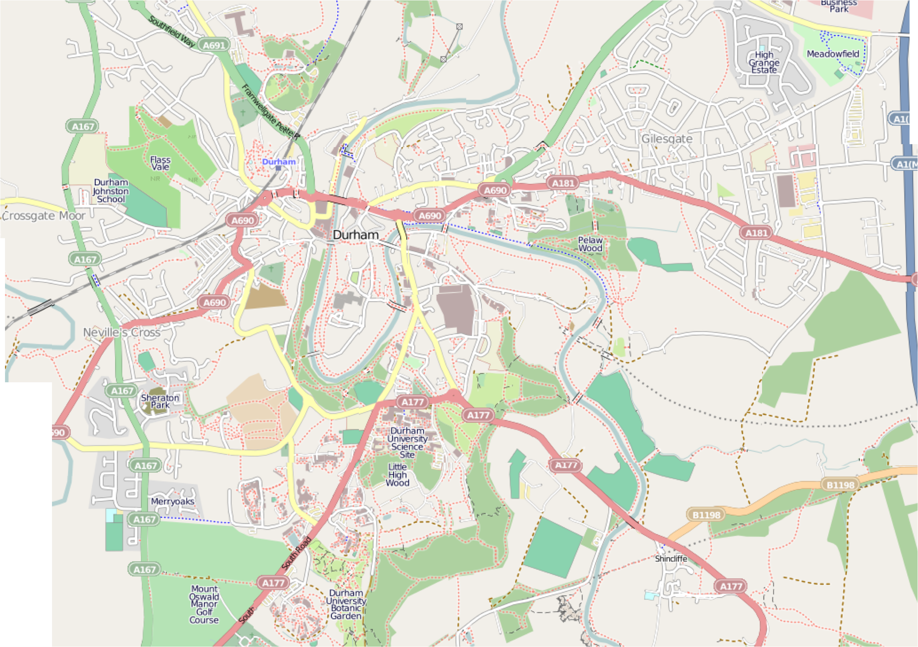
Areas of Durham
Claypath
Gilesgate
Viaduct
Elvet
Nevilles Cross
College

Slide 7
Average Price range
Claypath - £70-80
Gilesgate - £45-60
Nevilles Cross - £55-65
Viaduct - £75-85+
Elvet - £75-90+

Slide 8
Elvet
Pros:
- Close to the Science site, the DSU and Elvet Riverside
- Tend to be good quality accommodation
- Close to Butler and both Libraries
Cons:
Can be quite pricey
Expect plenty of drunk students walking past your house, oh and traffic!

Slide 9
Gilesgate
Pros:
- The cheapest area in Durham
- quite a lot of the houses will include bills
Cons:
- Can be quite a distance from the centre of Durham
- Can feel a little isolated compared to other student areas
- Far away from lectures at Elvet and the Science Site and Josephine Butler.

Slide 10
Claypath
Pros:
- Very close to the market square
- There are lots of takeaways in Claypath
- Close to the Gala, Loveshack and Freeman's Quay leisure centre (to work off those takeaways)
Cons:
- It tends to be more of a local area
- Houses tend to vary in quality, more so than in other areas
- Far away from Butler

Slide 11
Nevilles Cross
Pros:
- most houses are cheap, and some are really nice
- A lot closer to the science site than some might think
- Close to Butler
Cons:
- Quite far from town (and Tesco)
- It can feel a little bit isolated
- Expect to add taxi fares to your student budget

Slide 12
Viaduct
Pros:
- Popular Butler area
- Very close to the train station
- Close to Studio, Loft and Durham Live
Cons:
- Some houses can be very overpriced for what you get
- Can be quite far from lectures
- Can be noisy

Slide 13
What to look for in a house
Make sure they’re DSU accredited
Take along a checklist: - Does it suit your needs? – Room size, location etc. - Furnishings – Double Beds? TV included? - Bills, Internet, TV license included? - Double glazing? - Deposit, Is kept with the deposit protection sevice?
Don’t be afraid to ask questions
- How much are bills?
- What are the neighbours like?
- Have you had any issues with the landlord?
- Have you had any issues with the house? - What internet provider, price of line rental?

Slide 14
Valuable resources
Contacts...
Livers Out Officer – kyle.mcmanus@durham.ac.uk
Accommodation Office – Caroline.heslop@durham.ac.uk
Websites...
www.durhamstudentpad.co.uk
www.loveyourstudentlandlord.co.uk
Proctors
Dotted around so ask questions
Skype
JB-AccommodationHelpline

